Slide 1
Properties of
Regular Languages

Slide 2
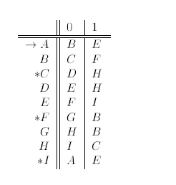
Courtesy Costas Busch - RPI

Slide 3
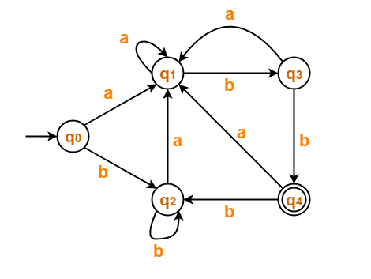
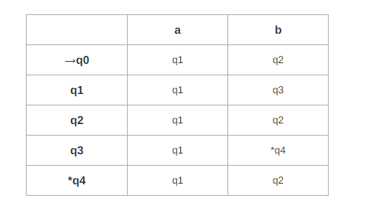
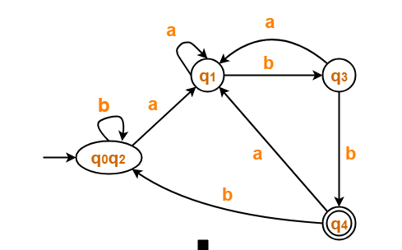




Courtesy Costas Busch - RPI

Slide 4




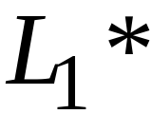
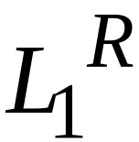


For regular languages and
we will prove that:
Union:
Concatenation:
Are regular
Languages
Star:
Reversal:
Complement:
Intersection:
Courtesy Costas Busch - RPI

Slide 5
A useful transformation: use one accept state
Any NFA can be converted
to an equivalent NFA
with a single final state
Courtesy Costas Busch - RPI

Slide 6



Example
NFA
Equivalent NFA
Courtesy Costas Busch - RPI

Slide 7
In General
NFA
Equivalent NFA
Single
final state
Courtesy Costas Busch - RPI

Slide 8
Extreme Case
NFA without final state
Add a final state
Without transitions
Courtesy Costas Busch - RPI

Slide 9
We say: Regular languages are closed under
Union:
Concatenation:
Star:
Reversal:
Complement:
Intersection:
Courtesy Costas Busch - RPI

Slide 10
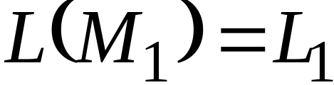
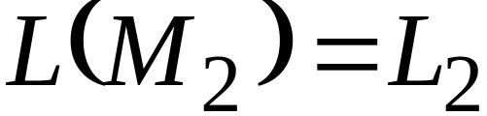


Let us take two languages
Regular language
Regular language
NFA
NFA
Single final state
Single final state
Courtesy Costas Busch - RPI

Slide 11

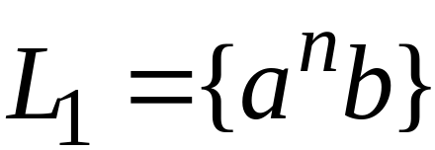
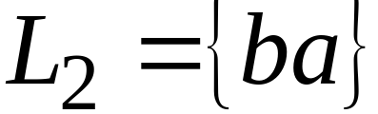
Example
Courtesy Costas Busch - RPI

Slide 12
Show Regular languages are closed under
Union:
Concatenation:
Star:
HOW?
Reversal:
Complement:
Intersection:
Courtesy Costas Busch - RPI

Slide 13
Union
NFA for
Courtesy Costas Busch - RPI

Slide 14
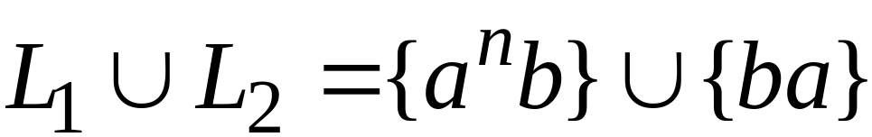
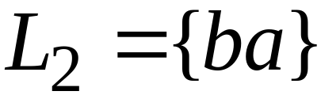
Example
NFA for
Courtesy Costas Busch - RPI

Slide 15
Show Regular languages are closed under
Union:
Concatenation:
Star:
HOW?
Reversal:
Complement:
Intersection:
Courtesy Costas Busch - RPI

Slide 16
Concatenation
NFA for
Courtesy Costas Busch - RPI

Slide 17
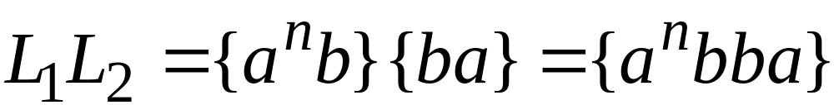
Example
NFA for
Courtesy Costas Busch - RPI

Slide 18
Show Regular languages are closed under
Union:
Concatenation:
Star:
HOW?
Reversal:
Complement:
Intersection:
Courtesy Costas Busch - RPI

Slide 19
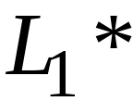
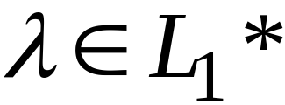
Star Operation
NFA for
Courtesy Costas Busch - RPI

Slide 20
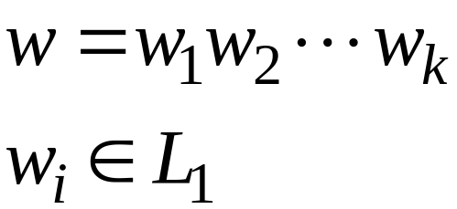
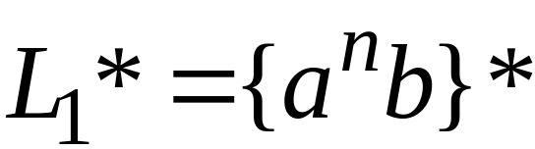
Example
NFA for
Courtesy Costas Busch - RPI

Slide 21
Show Regular languages are closed under
Union:
Concatenation:
Star:
HOW?
Reversal:
Complement:
Intersection:
Courtesy Costas Busch - RPI

Slide 22

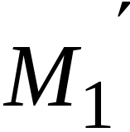
Reverse
NFA for
1. Reverse all transitions
2. Make initial state final state
and vice versa
Courtesy Costas Busch - RPI

Slide 23
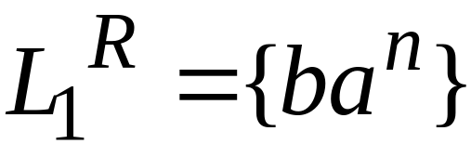
Example
Courtesy Costas Busch - RPI

Slide 24
Show Regular languages are closed under
Union:
Concatenation:
Star:
HOW?
Reversal:
Complement:
Intersection:
Courtesy Costas Busch - RPI

Slide 25
Complement
1. Take the DFA that accepts
2. Make final states non-final,
and vice-versa
Courtesy Costas Busch - RPI

Slide 26

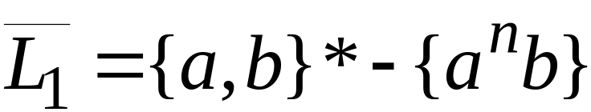
Example
Courtesy Costas Busch - RPI

Slide 27
Show Regular languages are closed under
Union:
Concatenation:
Star:
HOW?
Reversal:
Complement:
Intersection:
Courtesy Costas Busch - RPI

Slide 28
Intersection
regular
We show
regular
regular
Courtesy Costas Busch - RPI

Slide 29

Proof for Intersection Closure
Machine
Machine
DFA
for
DFA
for
Construct a new DFA that accepts
simulates in parallel and
Courtesy Costas Busch - RPI

Slide 30


simulates in parallel and
accepts string
if and only if:
accepts string
and accepts string
Courtesy Costas Busch - RPI

Slide 31




Another Proof for Intersection Closure
DeMorgan’s Law:
regular
regular
regular
regular
regular
Courtesy Costas Busch - RPI

Slide 32
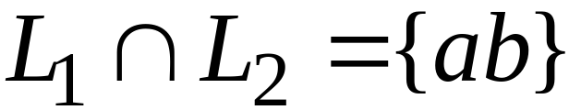
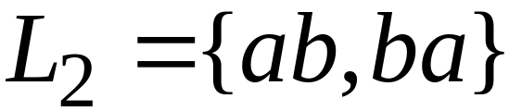
Example
regular
regular
regular
Courtesy Costas Busch - RPI

